Slide 1
Palatin Technologies, Inc.
NYSE American: PTN
CORPORATE PRESENTATION
September 2022
Carl Spana, Ph.D.
President & CEO
Stephen T. Wills, CPA/MST
CFO / COO

Slide 2
Forward Looking Statements
The statements in this presentation that relate to future plans, events or performance are forward-looking statements, which are made pursuant to the safe harbor provisions of Section 27A of the Securities Act of 1933, as amended. Such forward-looking statements involve significant risks and uncertainties, and actual results, events and performance may differ materially from those expressed or implied in this presentation. We have based these forward-looking statements largely on our current expectations and projections about future events and financial trends that we believe may affect our financial condition, results of operations, business strategy and financial needs. These forward-looking statements include, but are not limited to, statements concerning the following: (i) estimates of our expenses, future revenue and capital requirements; (ii) our ability to obtain additional funding on terms acceptable to us, or at all; (iii) our ability to advance product candidates into, and successfully complete, clinical trials; (iv) the initiation, timing, progress and results of future preclinical studies and clinical trials, and our research and development programs; (v) the timing or likelihood of regulatory filings and approvals; (vi) our expectations on sales and market acceptance for bremelanotide (Vyleesi®) for hypoactive sexual desire disorder (HSDD), a type of female sexual dysfunction (FSD), including our licensees outside North America jurisdictions; (vii) our expectation regarding timelines for development of our other product candidates; (viii) the potential for commercialization of our other product candidates, if approved for commercial use; (ix) our ability and the ability of our licensees to compete with other products and technologies similar to our product candidates; (x) the ability of third party collaborators to timely carry out their duties under their agreements with us and our licensees; (xi) the ability of contract manufactures to perform their manufacturing activities in compliance with applicable regulations; (xii) our ability to recognize the potential value of our licensing arrangements with third parties; (xiii) the potential to achieve revenues from the sale of our product candidates; (xiv) our ability to maintain product liability insurance at a reasonable cost or in sufficient amounts, if at all; (xv) the retention of key management, employees and third-party contractors; (xvi) the scope of protection we are able to establish and maintain for intellectual property rights covering our product candidates and technology; (xvii) our compliance with federal and state laws and regulations; (xviii) the timing and costs associated with obtaining regulatory approval for our product candidates; (xix) the impact of legislative or regulatory healthcare reforms in the United States; and (xx) other risks disclosed in our SEC filings. The forward-looking statements in this presentation do not constitute guarantees of future performance. We undertake no obligation to publicly update these forward-looking statements to reflect events or circumstances that occur after the date of this presentation.

Slide 3
Company Profile
Targeting the Melanocortin System is a platform for the development of drugs treating inflammatory & autoimmune diseases
Demonstrated expertise moving programs from discovery to FDA approval
Expertise in the biology and chemistry of the melanocortin system
1st company to procure FDA approval for a melanocortin agent (Vyleesi®)
Strategy leverages our chemistry and biology across multiple therapeutic opportunities
MOAs with the potential to modify underlying disease pathologies - not just treat symptoms

Slide 4
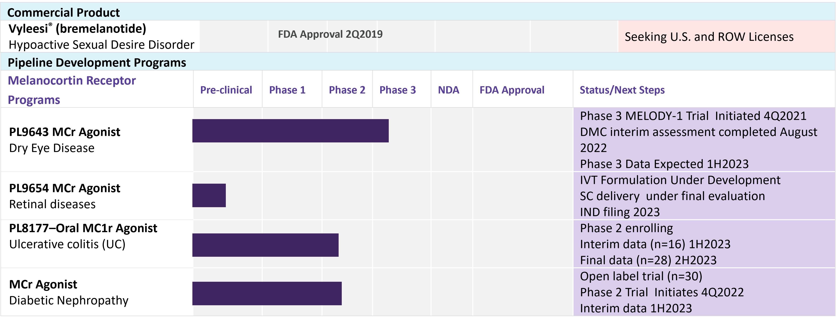
Commercial Product and Development Programs
Source: Company Filings

Slide 5
Developing Drugs to Address Unmet Clinical Need
Total Market Size of Palatin’s Clinical Programs (2021) ~ $20 Billion
Addressing unmet and unsatisfied medical needs, through safer better tolerated drugs in large markets.
Ulcerative Colitis
Need for safer, more tolerable UC products prior to steroids & biologics especially for pediatric patients
Market Size (2021) ~$5.5 Billion
Dry Eye Disease
Need for treatments with efficacy and better ocular tolerability
Market Size (2021) >$5.0 Billion
PALATIN’S MELANOCORTIN PROGRAMS
Need for safer, more tolerable DR/DME products after or with anti-VEGFs
Market Size (2021) ~$10 Billion
Retinal Diseases

Slide 6
Target Milestones
Melanocortin System Inflammatory & Autoimmune Disease Programs | Date
PL9643 – Dry Eye
Phase 3 Melody 1 Initiated Phase 3 Melody-1 Interim Assessment Phase 3 Melody-1 Data | 4Q2021 Completed 1H2023
PL8177-Oral – Ulcerative Colitis
Phase 2 Proof-of-Concept initiated and enrolling patients Phase 2 Proof-of-Concept Interim data Phase 2 Proof-of-Concept Data | Started 3Q2022 1Q2023 1H2023
MCR Agonist - 2nd front of eye indication
Target IND filing | 1H2023
PL9654 Retinal indication
Target IND filing | 2H2023
Natriuretic Peptide System Cardiovascular & Fibrosis Programs
PL3994 – Heart Failure Preserved Ejection Fraction
Open label Phase 2 Data | 2H2022
Vyleesi (bremelanotide) for Hypoactive Sexual Desire Disorder
North American rights regained | 3Q2020
S. Korea licensee PK study enrolling Data | 1H2023
Re-license North American rights / Additional ROW partnerships | 2H2022
Data
Status/Completion
Notes:
Need column headings

Slide 7
Melanocortin Inflammatory & Autoimmune
Disease Programs
Pioneering a new way to treat patients, and
meeting the need for safe effective treatments.

Slide 8
The Inflammatory Process in Health and Disease
Excessive Response
Non-Resolving/Chronic
Inflammation
Tissue Damage
Balanced Response
Pharmacological Resolution:
Melanocortin System
Tissue Protection
Onset Phase
Resolution Phase
Melanocortin System
LTB4
PGD2
PGE2
Resolvins
TNF-⍺
IL - 1β
Protectins
Sugimoto MA, Sousa LP, Pinho V, Perretti M and Teixeira MM (2016) Resolution of Inflammation: What Controls Its Onset? Front. Immunol. 7:160.
Notes:
Current therapies work on inflammatory response. MCs can convert inf cells to kickstart resolution phase of process. MCs work in a different way from other treatments. For bottom: Orange is Pathways and markers for inflammation. Want to show that there are other therapies

Slide 9
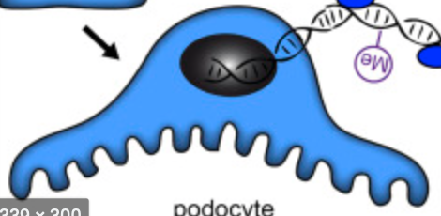
Multiple Pathways From MCR Agonism to Resolution of Inflammation
MCR Agonism
MCR agonism changes Immune cell
phenotypes to non-inflammatory
d
Glial
Endothelial
Epithelial
Dendritic
d
Podocytes
Melanocytes
MCR agonism reduces Stress signaling by Resident cells to Immune cells
Macrophages
T-cells
Natural Killer
Eosinophils
B-cells
Neutrophils
Basophils
Resident and Immune cell interaction, in concert with MCR agonism, results in return to normal homeostasis and promotes tissue healing
Resolution of Inflammation

Slide 10
Melanocortin Therapeutics Have Broad Utility
Targeting the Melanocortin System a platform for drugs to treat inflammatory diseases
EYES (PL9643; PL9654)
BRAIN (VYLEESI®)
Palatin’s therapeutics work by activating endogenous melanocortin pathways to resolve damaging inflammation and promote tissue healing
LUNG (Lead ID)
KIDNEY (Lead ID)
COLON (PL8177)

Slide 11
Validating the Melanocortin System
Goal: Validate the Melanocortin system as a new target for the development of drugs to treat multiple inflammatory and autoimmune diseases
Why: Potential for a new class of drugs not based on immune suppression with better efficacy, tolerability and safety to address significant unmet medical need in large markets
Strategy
Advance the science using the latest in genomic and proteomic technologies
Multiple publications and presentations
Translate preclinical findings into clinical data in multiple indications to demonstrate depth of mechanism
Ph. 3 dry eye disease, Ph. 2 ulcerative colitis & ph. 2 diabetic nephropathy
Build a portfolio of drugs for ocular indications

Slide 12
Ocular

Slide 13
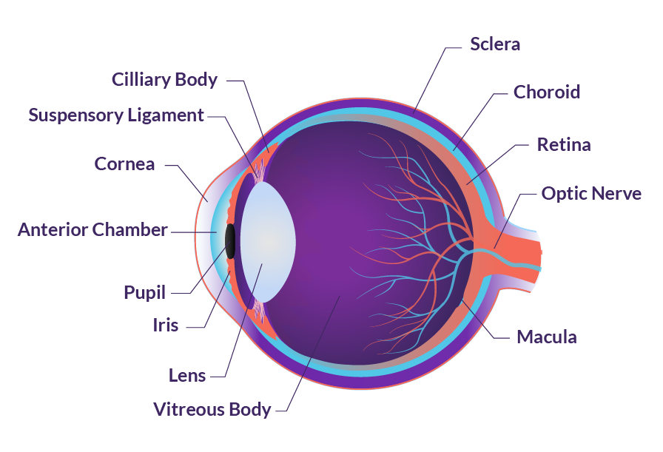
Ophthalmic Diseases with Unmet Medical Need: Front to Back
Conjunctiva/Cornea/Ocular surface
Dry eye
Cornea endothelium
Protect donor corneas for transplantation
Improve corneal transplant survival
Protection of cornea with cataract surgery
Fuchs Dystrophy
Iris/Ciliary Body/Choroid
Non-infectious uveitis
Retina
Diabetic retinopathy
Age-related macular degeneration
Optic nerve
Glaucoma
EYE ANATOMY

Slide 14
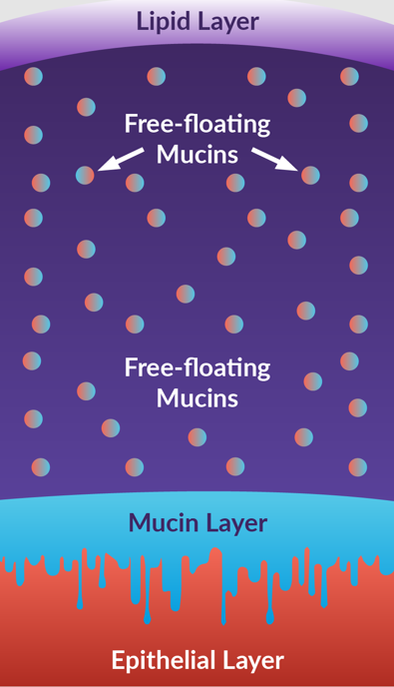
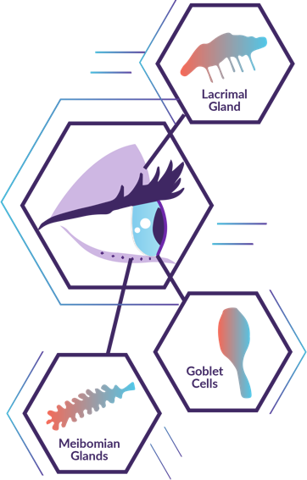
Dry Eye Overview
Dry eye disease (DED) or keratoconjunctivitis is a multifactorial disorder of the tears and ocular surface
Symptoms include dryness, irritation, redness, discharge and blurred vision
Inflammation plays a prominent role in the development and amplification of the signs and symptoms of DED
Current Treatments ~$5 billion in revenue
Restasis®-topical cyclosporin
Xiidra®-topical integrin inhibitor
Topical steroids
Artificial tears
Current treatments have efficacy and tolerability issues and there remains a high medical need for new innovative treatments that affect underlying disease processes

Slide 15
Compliance Remains an Issue with Current SOC Therapies Poor tolerability leads to high discontinuation rates
Patients Receiving Rx for Dry Eye (48%)⁷
Response Rate
68-80%¹⁻⁴
Discontinuation Rate
70.8% ^{6**}
Response Rate
Unknown
Discontinuation Rate 64.4% ^{6**}
Due to ^{8*}
Due to ⁸*
Burning 72%*
Burning 64%*
Slow onset of effect 29%
Slow onset of effect 11%
Altered sensation of taste 21%
Altered sensation of taste 56%
Blurred vision 37%
Blurred vision 50%
Ineffective relief of dry eye 31%
Ineffective relief of dry eye 22%
Side effects such as burning, blurry vision, and bad taste are main reasons for poor compliance, while lack of efficacy is also a main driver for discontinuation of Restasis
*Note: Percentage value indicates the proportion of participants who experienced the side effect ** Note: Discontinuation rates within 12 months based on 2021 Real World study; side effects listed are not directly connected to discontinuation rate
Sources: 1. Sall K et al., (2000); 2. Schultz et al., (2014); 3. Torricelli et al., (2014); 4. Williamson et al., (2015); 5. Mah et al,. Clin Ophthalmol (2012); 6. White et al. Clin Ophthamol (2019); 7. Lum et al. Amer. Academy of Optometry (2018), 8. White et al. Clin Ophthalmol (2020)

Slide 16
Approximately 16MM People Diagnosed with DED in U.S. An estimated ~7MM may be open to new treatment
DED EPIDEMIOLOGY
DED Population
Potential Addressable DED Population
~16M
~50% of the estimated 34M people in the U.S. with dry eye have been diagnosed
80% of patients ever treated are willing to try a new treatment
16
14
12
10
~7.3M diagnosed patients not satisfied with current treatments and are willing to try new treatments
U.S. Patients (M)
~7M
~7M have tried and failed currently available treatments
8
6
4
<2M
<2M are currently on Rx therapy (i.e., Restasis and Xiidra)
2
86% of patients currently treated are willing to try a new treatment
0
Currently Diagnosed
Ever Treated
Currently Treated
Notes:
Key Communication Points
DED is believed to be one of the most common eye diseases in the United States¹
29 million American adults suffer from symptoms of DED, which is equivalent to 1 out of 7 American adults^{2,3}
References
Schaumberg DA, Sullivan DA, Buring JE, Dana MR. Prevalence of dry eye syndrome among US women. Am J Ophthalmol. 2003;136(2):318-326.
Paulsen AJ, Cruickshanks KJ, Fischer ME, et al. Dry eye in the beaver dam offspring study: prevalence, risk factors, and health-related quality of life. Am J Ophthalmol. 2014;157(4):799-806.
US Census Bureau. Annual estimates of the resident population for selected age groups by sex for the United States, states, counties, and Puerto Rico Commonwealth and municipios: April 1, 2010 to July 1, 2012. http://factfinder.census.gov. Published June 2013. Accessed September 15, 2015.
Title:
Schaumberg 2003_318B
29M MATH:
US Census number for 2012 (25-84) = 202,938,707 x 14.5% = 29.43M
Slide:
2012 US Census_4A; Paulsen_799B
1 in 7 MATH:
29,426,113 American adults (25-84) with symptoms of DED out of 202,938,707 American adults (25-84) equals 1 out of every 6.89 adults, or 1 out of every 7 (rounded up)

Slide 17
PL9643 DED Program Summary
PL9643 a novel approach to treat Dry Eye Disease (DED) targeting the melanocortin system to resolve pathological inflammation and promote tissue healing
MELODY-1 phase 3 study innovative adaptive design
Interim analysis completed August 2022
Data 1H2023
PL9643 Eye Drops
PL9643 peptide agonist at the melanocortin receptors 1&5, pending patent application runs to 2041
Positive phase 2 study significant efficacy for multiple sign and symptom end points, with excellent ocular safety and tolerability
PL9643 treats inflammation underlying the development and maintenance of DED, addressing both signs and symptoms of DED
MELODY Phase 3 registrational Program is evaluating multiple signs and symptoms of DED

Slide 18
PL9643 Dry Eye Phase 2 Results
Met primary objective of providing data required to advance into registration studies
Statistical significance for the primary endpoints was not achieved in the ITT population that included mild, moderate, and severe patients
In the sub-population of moderate to severe patients (N=53), PL9643 achieved statistical significance (P value <0.05 vs. vehicle) at week 2 and week 12 for multiple signs and symptoms
PL9643 demonstrated excellent ocular safety and tolerability
Differentiated & Favorable emerging product profile
No drug related serious adverse or adverse events
No drug related discontinuations
High ocular comfort
Rapid onset, excellent tolerability, safety and global efficacy

Slide 19
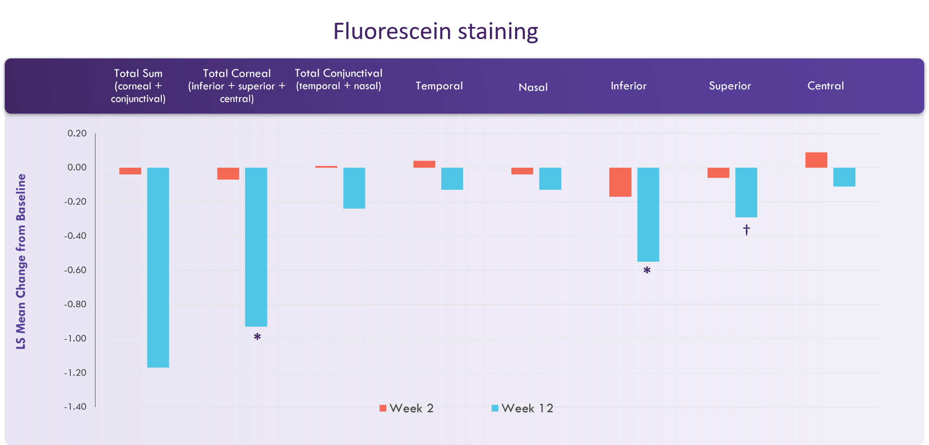
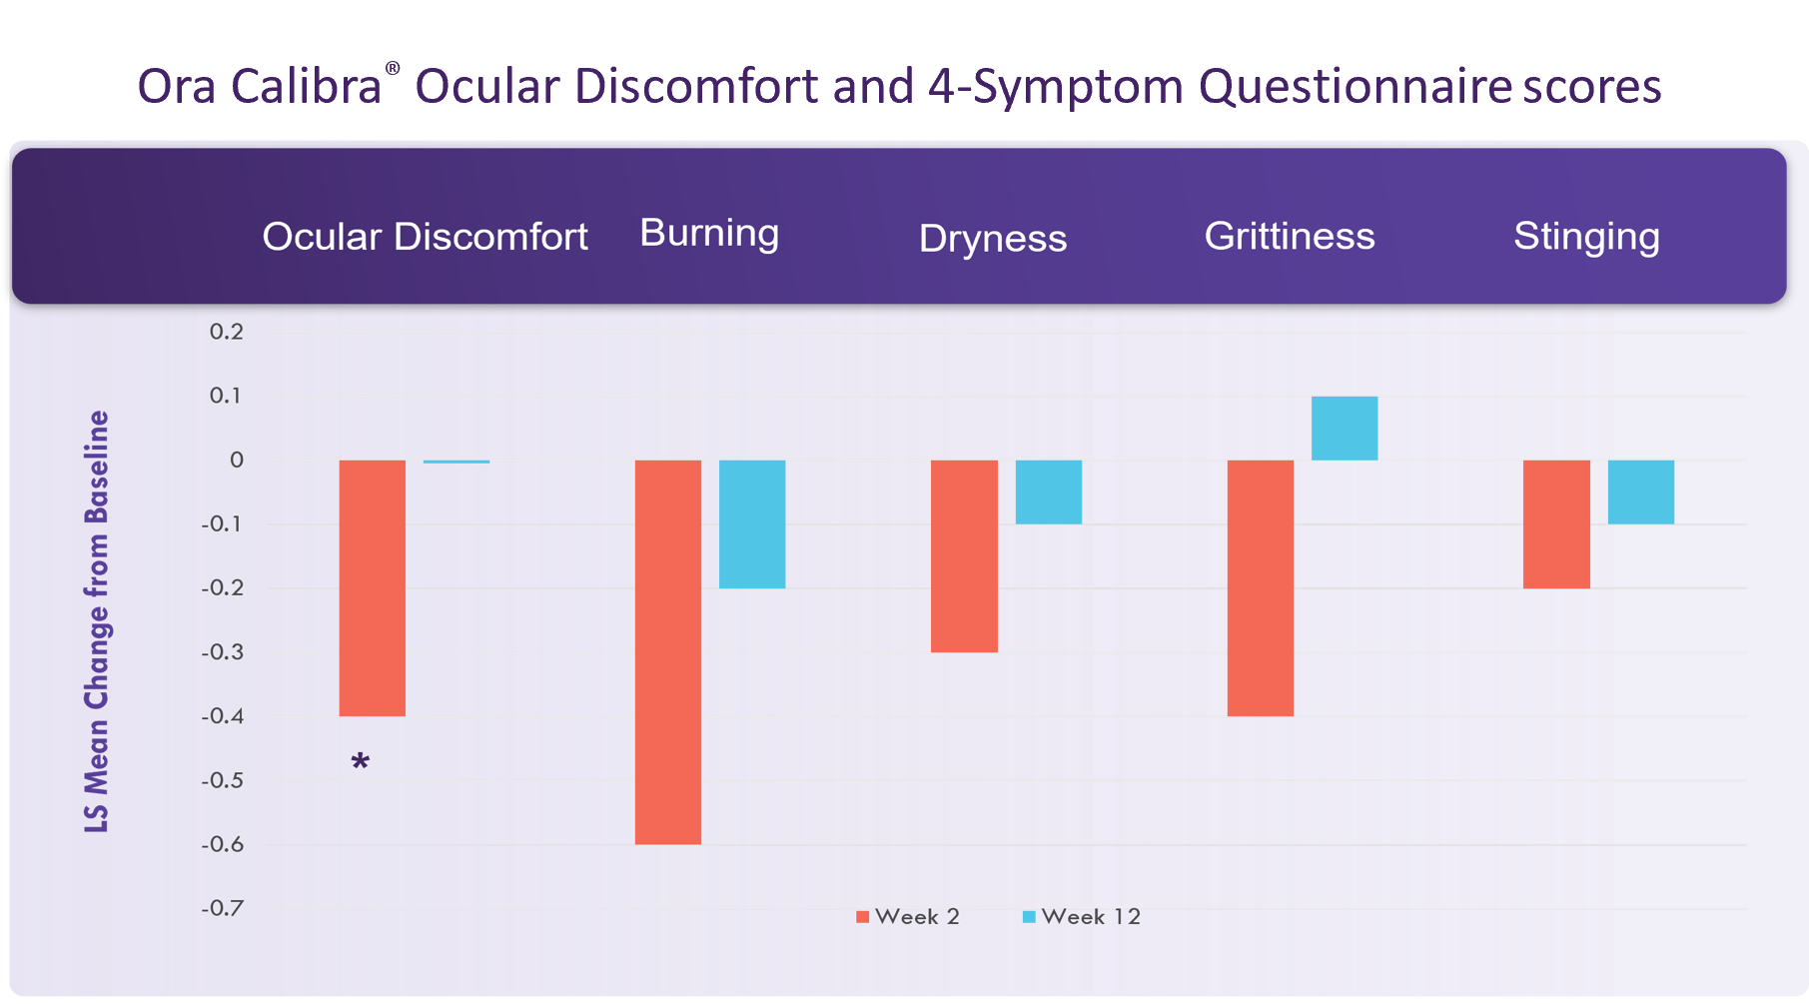
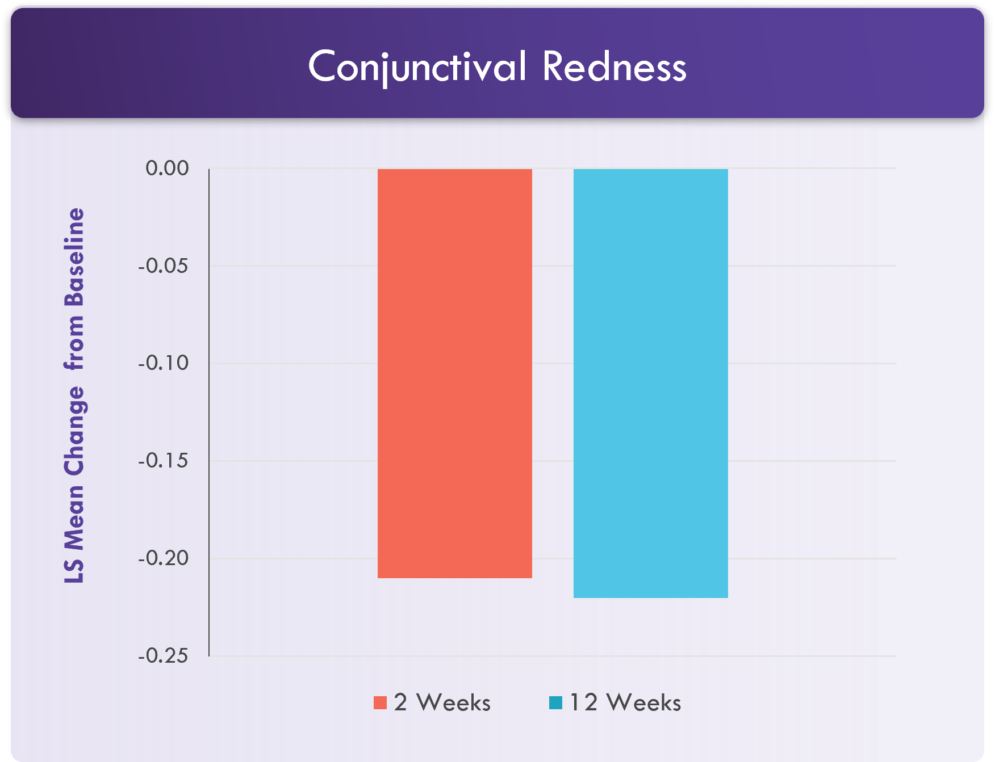
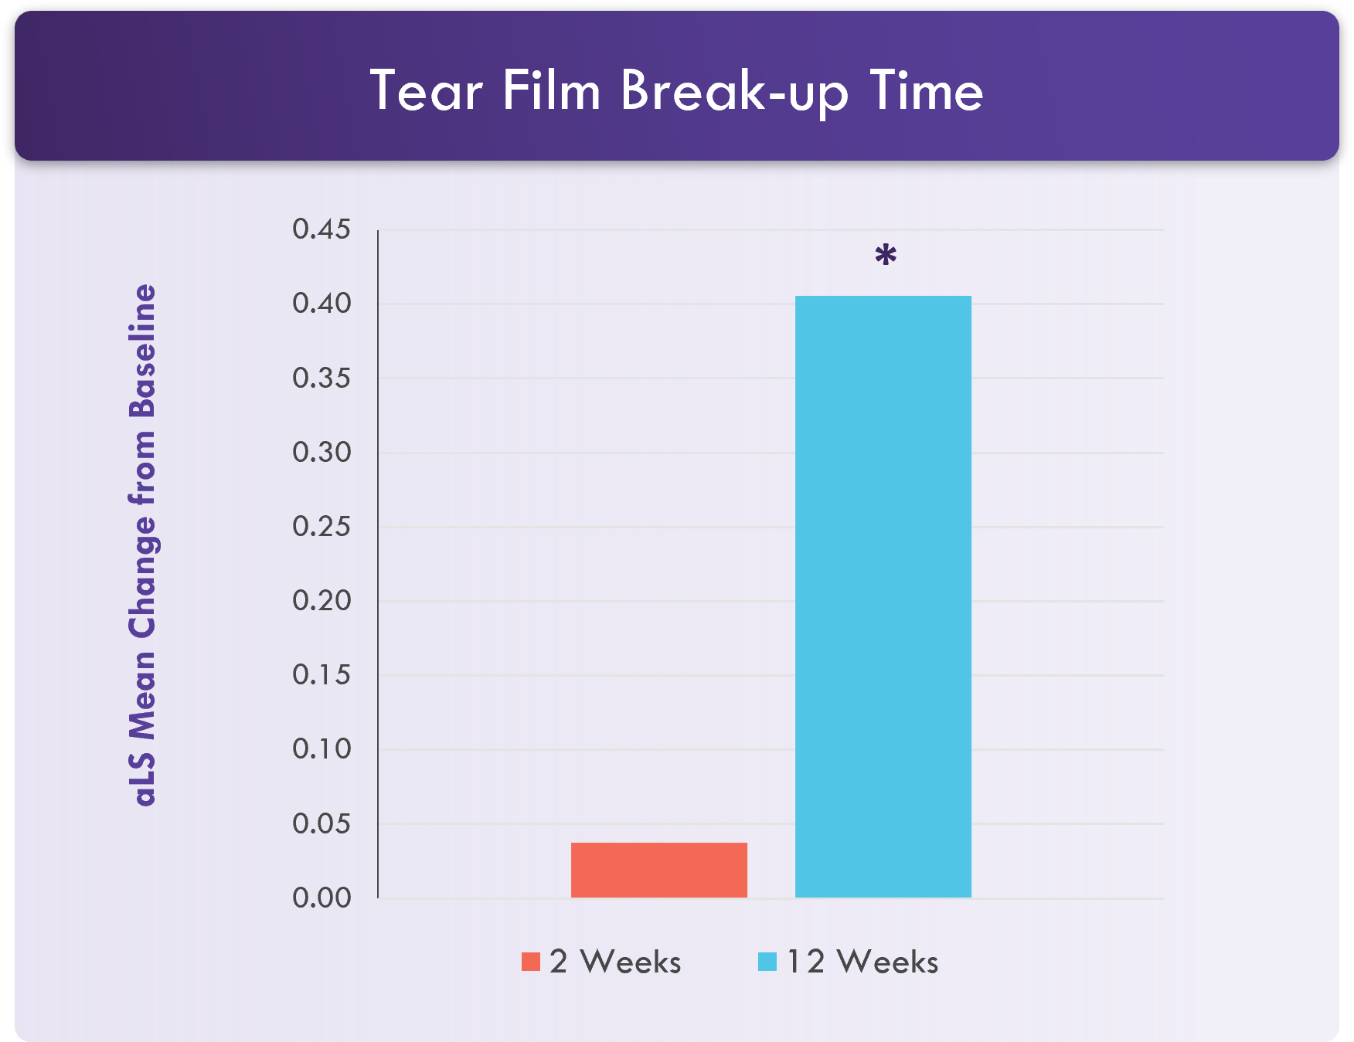
Phase 2 Study - Signs Differences Between PL9643 and Vehicle Least squares change from baseline moderate/severe subgroup (n=53)
*P<0.05; †P<0.1

Slide 20
Phase 3 Study Design & Endpoints Based on DMC Recommendations
12-week, multicenter, 1:1 randomized, double-masked, vehicle-controlled adaptive design study
Evaluate the efficacy and safety of PL9643 in up to 350 adults (initial target N=240) with moderate or severe dry eye disease Disease duration ≥ 5 years; Inferior Corneal Staining score >1; Eye Discomfort score ≥ 25 as measured by the Visual Analog Scale
DMC Interim Assessment
N=120
12
Week
Screening
–2
Randomization
0
2
4
6
8
10
Placebo run-in
N=240 - 400
mod or sev subj
1 µg/mL PL9643 ophthalmic solution 3 times daily
Placebo ophthalmic solution (vehicle) 3 times daily
Visit type
CAE® screening
CAE® confirmation/baseline
CAE®
follow-up
CAE®
follow-up
no study visit
CAE®
follow-up
no study visit
CAE®
follow-up
Sign Endpts
Symptom Endpt
Inferior corneal fluorescein staining
Total conjunctival lissamine green staining (Nasal + Temporal Regions)
Ocular discomfort
CAE®, controlled adverse environment.

Slide 21
PL9643 DED Program Timelines Adjusted for DMC Recommendations
Phase 2 Results
MELODY-1 FPI
Interim Assessment
Original Plan
MELODY-1 TFLs & CSR
Additional 230 Patients
NDA
Submission
EOP2 meeting
MELODY-1 TFLs & CSR
MELODY-2 & 3 TFLs & CSR
2021
2022
2023
2024
PL9643-301 MELODY-1 (Efficacy) initiated 4Q2021
76 days
PL9643-302 MELODY-2 (Efficacy)
19 days
PL9643-303 MELODY-3 (Safety)
168 days
167 days
448 days

Slide 22
PL9643 Dry Eye Commercial Opportunity
DIFFERENTIATED PRODUCT
UNMET MEDICAL NEEDS
SPEED/SAFETY/TOLERABILITY
LARGE MARKET OPPORTUNITY
PL9643 has a very favorable commercial product profile compared to approved therapies
Quick onset of efficacy
Superior safety profile
Superior patient tolerability
Ideal profile for chronic use
Current FDA approved treatments have high discontinuation rates due to high rates of side effects and slow onset of efficacy leading to patient and clinician dissatisfaction
DED is estimated to affect over 34 million people in the United States
~16M people diagnosed with DED in U.S.
~7.3M diagnosed patients not satisfied with current treatments and are willing to try new treatments
Rx market ~$1.2b in 2021 and projected to be >$1.6b in 2026

Slide 23
PL9654 for Retinal Diseases

Slide 24
Why a Melanocortin Peptide for Retinal Disorders?
PL9654 for Retinal Disorders
The total retinal disorders drug market, USD $20 billion in 2021, projected to be $27 billion by 2026; DR/DME estimated ~$10 billion
Retinal disorders can significantly impair vision preservation of vision is the key outcome for drug treatment
High need for new products with enhanced safety and efficacy to delay progression, maintain and improve visual acuity, rescue treatment failures
PL9654 is a highly potent melanocortin agonist with potential for less frequent IVT dosing, once every ~3-6 months
Market is seeking replacement for steroids without glaucoma or cataract side effects
PL9654 is not systemically absorbed allowing potential for excellent efficacy without safety concerns
Our melanocortin receptor agonists have been evaluated in multiple animal models of retinal disease where preservation of vision was demonstrated
Notes:
DME affects ~10% of people with diabetic retinopathy
~750,000 in the USA & 2.2 million people in the EU
IVT VEGF antagonists and steroids are the main treatments for DR/DME
Global 2020 market for DR reached a value of $7.6 billion, and is estimated to reach $10.8 billion in 2025
Global 2027 market for DME is estimated to reach $4.1 billion by 2027
There is a high need for additional treatments
To delay progression, maintain and improve visual acuity
Replacement for steroids without glaucoma or cataract side effects
Our melanocortin agonists have been evaluated in multiple animal models of retinal disease

Slide 25
Preclinical Proof-of-Concept
To validate melanocortin receptors as therapeutic targets for retinal diseases, Palatin’s melanocortin agonist compounds were tested in two relevant animal models
Laser-Induced Choroid Neovascularization (CNV) Model
Diabetic Retinopathy Model
25

Slide 26
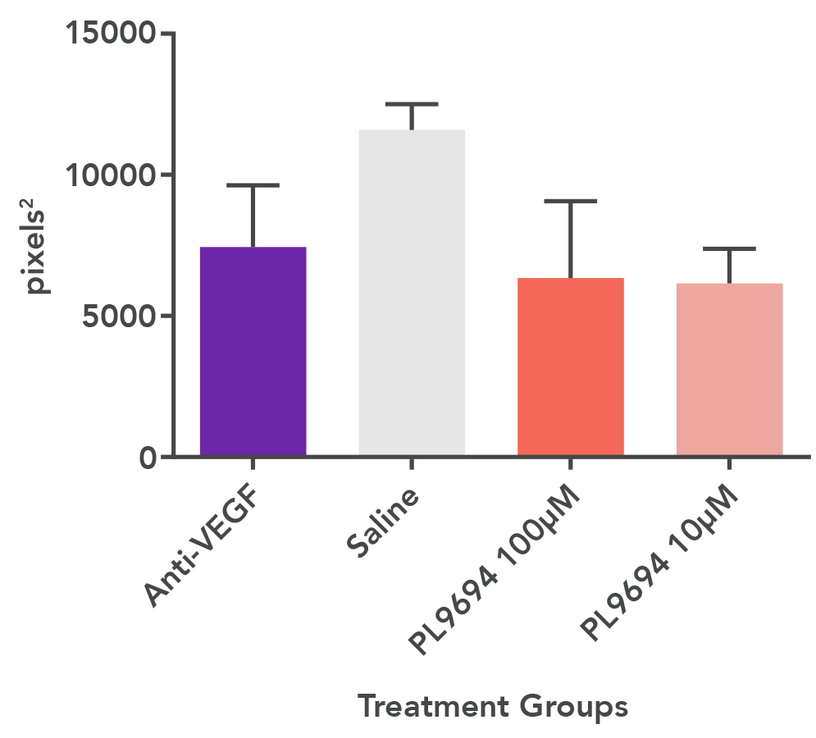
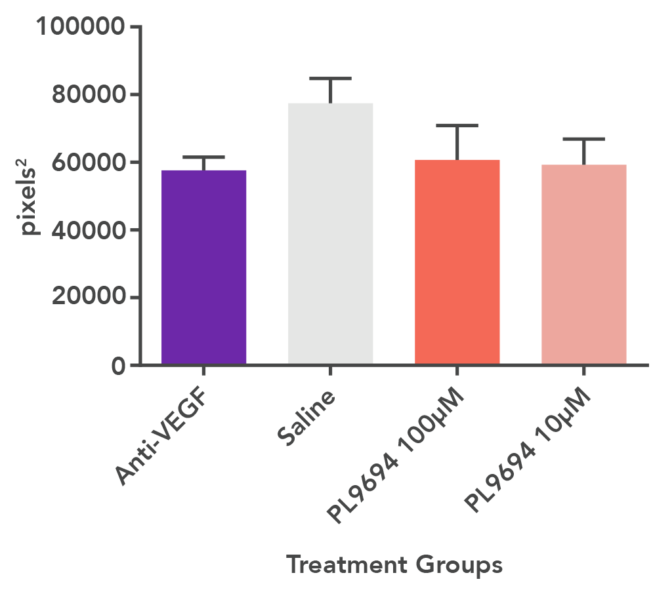
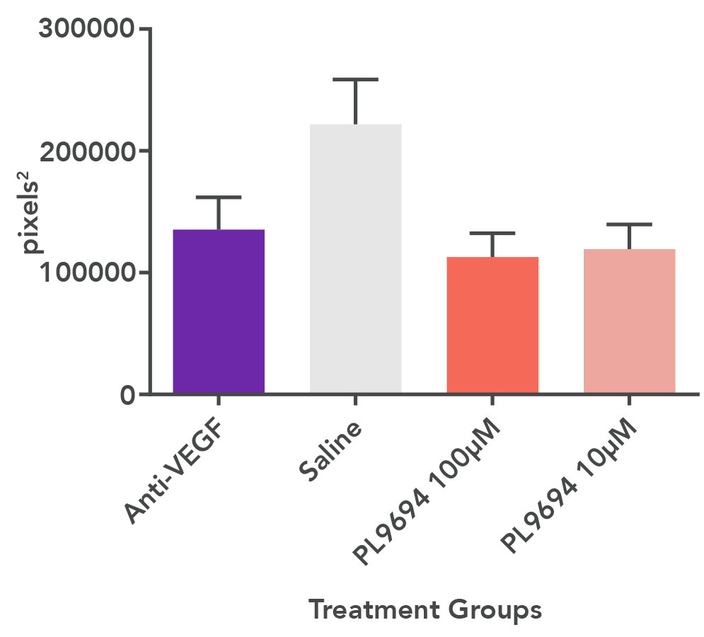
PL9654 Laser Induced Choroid Neovascularization Model
Model recapitulates main features of human age-related macular degeneration (AMD)
MEAN LEAKAGE AREA
MEAN AREA OF ANGIOGENESIS
MEAN AREA OF FIBROSIS
PL 9654 100μM
PL 9654 10μM
PL 9654 100μM
PL 9654 10μM
PL 9654 100μM
PL 9654 10μM
Treatment Groups
Treatment Groups
Treatment Groups
PL9654 showed therapeutic activity comparable to anti-VEGF positive control
CNV leakage area reduced
Angiogenesis area reduced
Fibrosis area reduced (better than anti-VEGF)

Slide 27
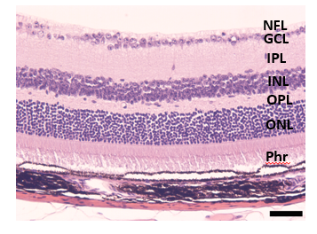
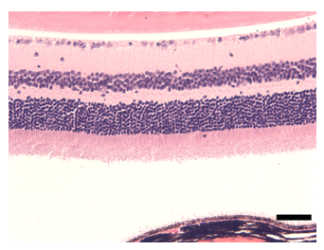
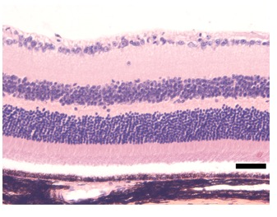
Diabetic Retinopathy Model
Melanocortin agonist demonstrated key indicators of improve retinal health, including:
Preserved retinal anatomy
Suppressed pro-inflammatory cytokine to healthy control levels
Increased levels of IL-10, a marker of inflammation resolution
Healthy Control
Diabetic; Untreated
Diabetic; melanocortin agonist
This rodent model develops diabetic retinopathy similar humans

Slide 28
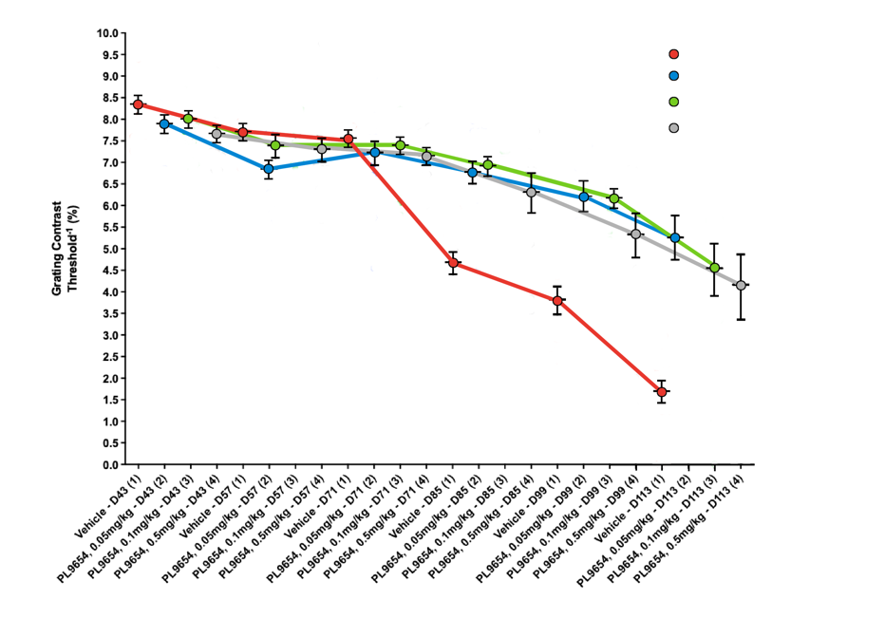
PL9654 in a Rat Diabetic In-Life Retinopathy Model
CONTRAST VISION
Vehicle
0.05 mg/kg
0.1 mg/kg
0.5 mg/kg
PL9654 preserves contrast vision as compared to controls
A 2nd measure of visual acuity demonstrated similar efficacy

Slide 29
Retinopathy – Desired Target Product Profile to Determine Commercial Success
Efficacy
Pharmacokinetics (ROA)
Safety
PL9654 was chosen based on:
High potency at melanocortin receptors 1 & 5
Enables smaller needle, fewer AEs
Demonstrated efficacy in preclinical animal models
Enabling pharmacokinetics
Desirable solubility profile
Straight-forward synthesis path
Excellent IP position
PL9654 Ongoing Activities:
IVT sustained release formulation development (target is 3-6 months sustained dose)
Additional preclinical models and measurements
Genomic and proteomic characterization of treated animal models
Extensive PK
Validating SC as a delivery option
Toxicology studies
PL9654
IND enabling studies and subsequent clinical studies are planned
IVT formulation minimal/no systemic exposure toxicology studies
PL9654 IVT sustained release formulation under development
Potential for intermittent SC delivery which is preferred by patients
29

Slide 30
PL8177 for Ulcerative Colitis

Slide 31
Why a Melanocortin Peptide for Ulcerative Colitis?
PL8177 Oral Formulation for Ulcerative Colitis
Global ulcerative colitis (UC) market USD $5.5 billion 2021, projected to be $8 billion by 2026
PL8177-205 ph. 2 study evaluating safety and efficacy of PL8177-Oral in UC patients, interim assessment 1H2023 final data 2H2023
Most treatments for UC are systemic and have tolerability and safety limitations
MC1r on colon epithelial cells is accessible from the lumen of the colon. PL8177-Oral demonstrated robust efficacy in UC animal models
PL8177 is not systemically absorbed
Potential for excellent efficacy without safety concerns
Phase 1 SC SAD/MAD study - no significant findings
Oral Phase 1 study – confirms colon delivery
PL8177 is a highly potent selective agonist at the MCr1
“Currently available therapies cannot cure IBD, but many of them target various inflammatory pathways, resulting in more or less durable remission. However, these therapies come at a high price economically and physically, with potentially life-threatening side effects.”
N. ENGL J MED 385:14 September 30, 2021
Notes:
DME affects ~10% of people with diabetic retinopathy
~750,000 in the USA & 2.2 million people in the EU
IVT VEGF antagonists and steroids are the main treatments for DR/DME
Global 2020 market for DR reached a value of $7.6 billion, and is estimated to reach $10.8 billion in 2025
Global 2027 market for DME is estimated to reach $4.1 billion by 2027
There is a high need for additional treatments
To delay progression, maintain and improve visual acuity
Replacement for steroids without glaucoma or cataract side effects
Our melanocortin agonists have been evaluated in multiple animal models of retinal disease

Slide 32
Opportunity for PL8177 in UC Treatment Landscape
Severity: Mild
Patient number: Large
Moderate
Severe
Small
5-ASA (Lialda)
Low
5-ASA
failure
PL8177
Steroids enema/ suppository
Drug
Price
Steroids oral
Steroids infusion
Treatment flow
Biologics & Immuno-moderators
Remission induction
(Adalimumab BS)
Surgical Operation
High
5-ASA (Lialda)
Low
PL8177
Drug
Price
Treatment flow
Biologics & Immuno-moderators
(Adalimumab BS)
Remission maintenance
High

Slide 33
PL8177 Pre-Clinical Histological Findings (Total Colitis Index in Rats)
The scoring was based on examining three sections from each colon per animal:
Sections were taken at the distance of 2.5cm, 5cm and 7.5cm from the anus
Total colitis index includes observations
Abnormalities of mucosal architecture
Extent of inflammation
Erosion or ulceration
Epithelial regeneration
Percentage involvement by the disease process

Slide 34
PL8177-205 Phase 2 Study Design & Timelines
Phase 2 RCT parallel group study using an adaptive design to evaluate safety, tolerability and efficacy
2021
2022
2023
2024
PL8177 oral Drug Product manufacturing
PL8177-205 Oral UC Study Part B (N=12)
LICENSING
PL8177 Oral
PL8177-205 Oral UC Study Part A (N=16)
Patient Population:
Adult patients with active UC
Modified Mayo endoscopic subscore ≥2, and Fecal Calprotectin > 250 mcg/g
Intolerance, lack of response aminosalicylates
Primary Safety Endpoints:
• The overall incidence of treatment-emergent adverse event(s) (TEAEs)
Primary Efficacy Endpoint:
• Proportion of patients that have MES of 0 or 1 (endoscopic improvement)
Interim Assessment N=16
FULL DATA N=28
76 days
19 days
168 days
167 days
Time Point | Dosing Regimen | Placebo | PL8177
Leading into the Interim Assessment | QD | n = 4 | n = 12
Target Sample Size Following the Interim Assessment | QD | n = 7 | n = 21
448 days
Notes:
• Comparison of concentrations of plasma PL8177 and its main metabolite
Comparison of concentrations of PL8177 and its main metabolites in fecal samples.
Biomarker endpoints:
• The change in CRP levels.
• The change in fecal calprotectin and lactoferrin levels.
• The change in blood, fecal, and mucosal tissue lysate levels of inflammatory cytokines.
Exploratory endpoints:
• Blood and intestinal samples will be used for the genomic assessment of immunological cells.
• Blood will be collected and frozen for determining immune cell type population proportions and composition by single cell analysis.
• Intestinal biopsies will be collected and frozen for determining immune cell type population proportions and composition. B cell and T cell receptor clonality will also be determined.

Slide 35
Ulcerative Colitis – Target Product Profile for Commercial Success
Efficacy
Pharmacokinetics (ROA)
Safety
PL8177 in animal models and Phase 2 planned:
High potency at melanocortin receptors 1
Multiple positive animal models proof of efficacy data in gold standard disease model
Efficacy as good/better than 5-ASA and glucocorticoids in animal model data
Ph. 2 proof-of-concept trial enrolling patients
PL8177 oral formulation PK:
Phase 1 radiolabeled micro-dose study with the oral formulation, confirmed colonic delivery of oral PL8177
Orally dosed PL8177 remains in the colon – there is no systemic exposure
Phase 1 clinical SAD/MAD study with the systemic formulation (SC) completed, no adverse events or safety signals
No toxicological findings in pre-clinical studies doses >100-fold above planned clinical doses
PL8177 oral formulation meeting the program goals and positioned for success in Phase 2 POC
Interim data (n=16) 1H2023, final data (n=28) 2H2023
35

Slide 36
Vyleesi®

Slide 37
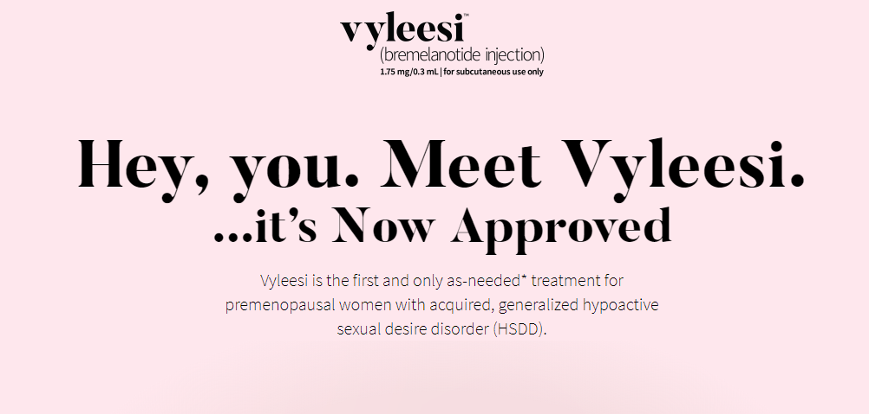
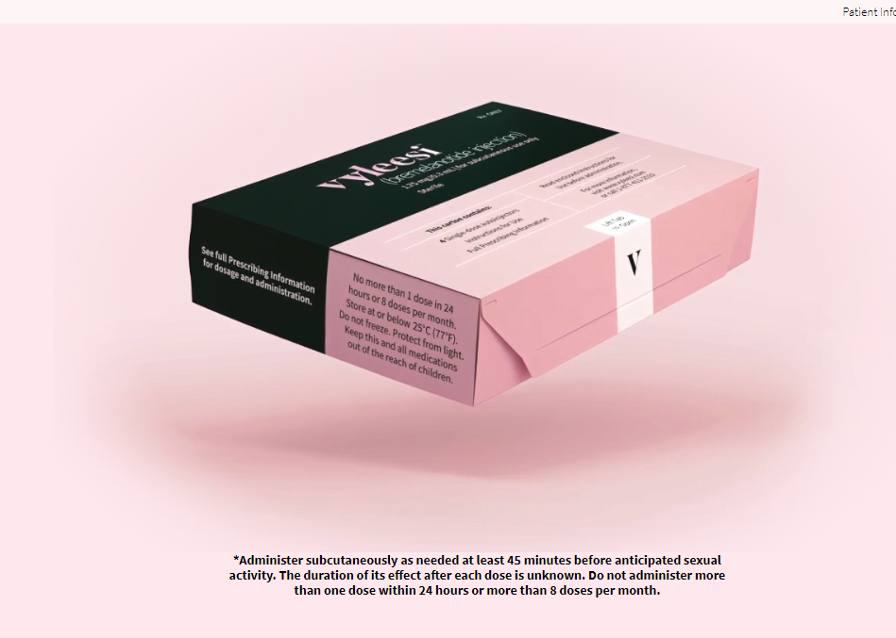
FDA Approved Vyleesi® For HSDD
Helping Premenopausal Women with Hypoactive Sexual Desire Disorder (HSDD)

Slide 38
Vyleesi – Melanocortin Receptor Agonist
Women with HSDD may have an imbalance of neurotransmitter activity in the brain that impacts sexual desire: too few excitatory signals, too many inhibitory signals, or both.²
Excitatory Signals
Inhibitory Signals
Dopamine
Norepinephrine
Oxytocin
Melanocortins (MCs)
Serotonin (5-HT)
Opioids
Endocannabinoids
Vyleesi is a melanocortin receptor agonist that non-selectively activates several receptor subtypes, the most relevant of which are MC1R and MC4R.^{1,2}
1. VYLEESI® (bremelanotide injection) Prescribing Information. 2019.
2. Kingsberg SA, et al. CNS Drugs. 2015;29(11):915-933.

Slide 39
HSDD is a Significant Market Opportunity
1/10^{1,2}
Affects 5.8 million U.S. premenopausal women³ (1 in 10 premenopausal women)^{1,2}
98% (5.7M) of affected premenopausal
women not on therapy³
Focused on relevant digital channels
Creating an online community for HSDD patients
Provide accurate information
Tools to support the HSDD patient - symptom check, speaking with your doctor and additional resources
Ensure HCP readiness, provide information and tools to diagnose and treat HSDD patients with Vyleesi
Number of premenopausal women who have low desire with associated distress
¹ Shifren JL, Monz BU, Russo PA, Segreti A, Johannes CB. Sexual problems and distress in United States women: prevalence and correlates. Obstet Gynecol. 2008;112(5):970–978.
² Goldstein I, Kim NN, Clayton AH, et al. Hypoactive sexual desire disorder: International Society for the Study of Women’s Sexual Health (ISSWSH) expert consensus panel review. Mayo Clin Proc. 2017;92(1):114‐128.
³ Palatin supported research that was performed by Burke, Inc., an ISO 20252–certified company, in compliance with the established standard for market, opinion, and social research.

Slide 40
Current Go-To-Market Approach
Objective: Re-license U.S. rights
Enhance brand value / improve net ASP, reimbursement, demand
Commercial Infrastructure
3 FTE sales reps (primarily inside / limited office visits)
1/2 FTE sales/marketing head / 1/2 FTE market access head / 1/2 FTE digital marketing
3rd-party partners enabled for administration and commercial support, media/marketing, and telemedicine
Palatin cross-functional support: regulatory, quality, CMC, finance, legal
Promotional Efforts
Limited FSD market awareness: opportunity for increased efforts/investment
Field sales and marketing efforts reaching/engaging hundreds of HCPs monthly
Digital marketing campaign with monthly reach to tens of thousands of target demographic
Reduced 3Q/4Q 2021 to review optimization opportunities / Revised target focus 1Q 2022 – 2Q 2022
Market access efforts prioritized to expand access and reimbursement
Retention and persistency efforts driving increased refills
1 FTE business analyst

Slide 41
Financial / Operational Fundamentals
WAC $899
Package size is a 4-pack (4 single-use autoinjectors)
Net ASP $275-$300
Increased execution of Prior Authorizations will drive greater reimbursement/insurance covered prescriptions
COGS ~$38 (4-pack)
GM ~87% of target net ASP
Distribution
Closed-network through one SP (KnippeRx)
Telemedicine platform
Prescribery- Access via Vyleesi.com
Patient assistance
Patient Pricing strategy – modified December 2021

Slide 42
Net Sales Analysis

Slide 43
Dispenses / % Refills
*Data source: TrialCard

Slide 44
Financial Snapshot
Financial Highlights as of March 31, 2022
Cash and Cash Equivalents | $37.7 million
Accounts Receivable | $0.8 million
Inventory | $1.0 million
Inventory Purchase Commitments (over the next 5 years) | $9.0 million
Summary Capitalization as of March 31, 2022
 | Common Shares and Equivalent
Common Stock | 231.7 million shares
Preferred | 0.1 million shares
Options | 21.7 million shares
RSUs | 13.0 million shares
Fully Diluted Shares | 266.5 million shares

Slide 45
Thank You.

